Slide 1

Statistical Fundamentals:
Using Microsoft Excel for Univariate and Bivariate Analysis
Alfred P. Rovai
Getting Started
PowerPoint Prepared by
Alfred P. Rovai
Microsoft® Excel® Screen Prints Courtesy of Microsoft Corporation.

Slide 2
Getting Started
Objectives
Understand the Excel worksheet layout
Enter data in an Excel worksheet
Perform arithmetic operations

Slide 3
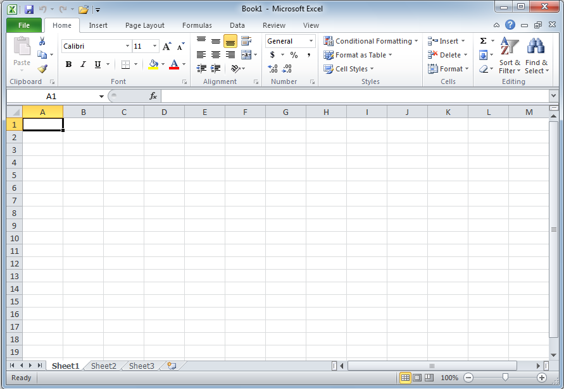
Launch Excel and open a new Excel Workbook (Windows version screenshot).
Excel ribbon with multiple tabs
Formula bar for active cell
Cell A1; active cell
Column headings;
Each column represents
a different variable or observation
Row headings;
each row represents a different case
Worksheet tabs

Slide 4
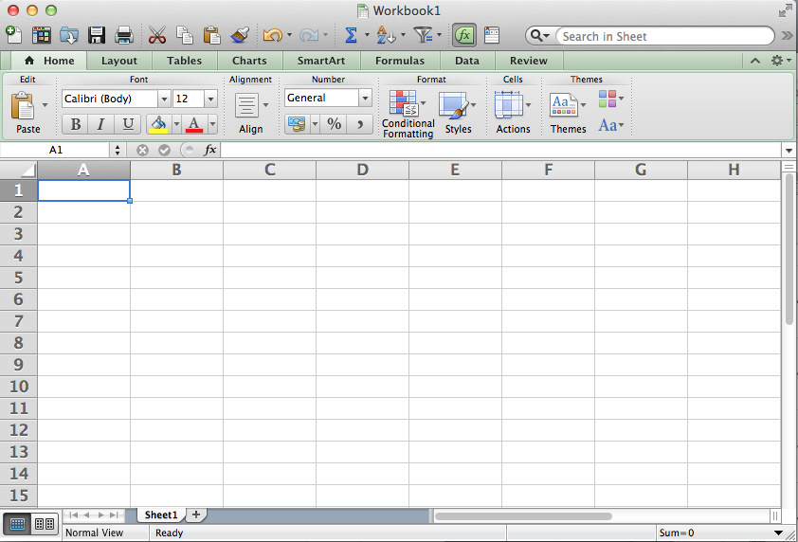
Launch Excel and open a new Excel Workbook (Macintosh version screenshot).
Excel ribbon with multiple tabs
Formula bar for active cell
Cell A1; active cell
Column headings;
Each column represents
a different variable or observation
Row headings;
each row represents a different case
Worksheet tabs

Slide 5
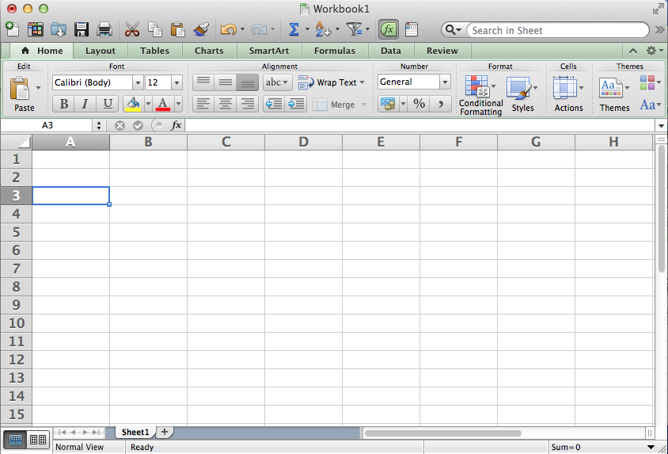
Cell A3; active cell
To make a cell active, simply click on that cell.
Use the mouse or the arrow keys or the return key to move around the worksheet.
For example, if you press the return key twice or the down arrow key twice
you move the active cell two cells down.

Slide 6
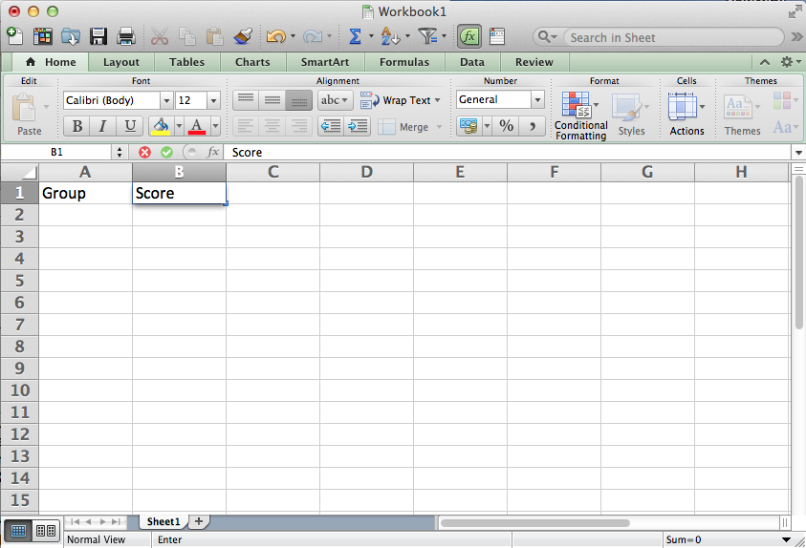
Name box
Formula bar
Cell B1; active cell
Typically, the first step in entering data is to enter variable names in row 1.
Note the name box identifies the address of the active cell and the
formula bar displays the contents of the active cell.

Slide 7
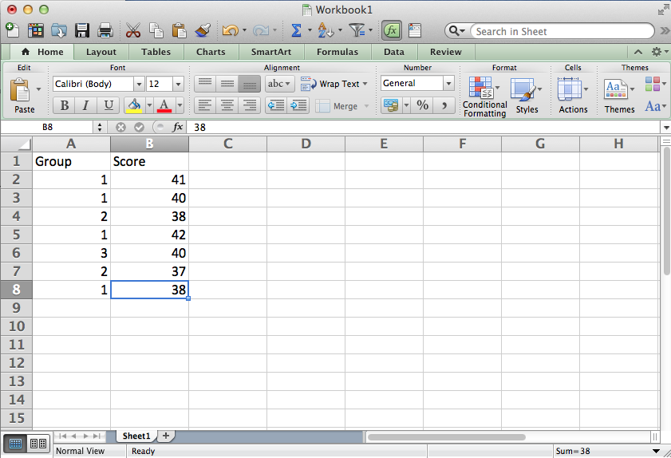
Name box
Formula bar
Cell B8; active cell
Data is entered one cell at a time. The above data reflect independent data with 3 groups.
Data are independent when the data for different subjects (cases) do not depend on each
other. Case 2 is in group #1 and has a score of 41. Case 3 is also in group #1 and
has a score of 40, etc. The format shown here is referred to as a stacked format.

Slide 8
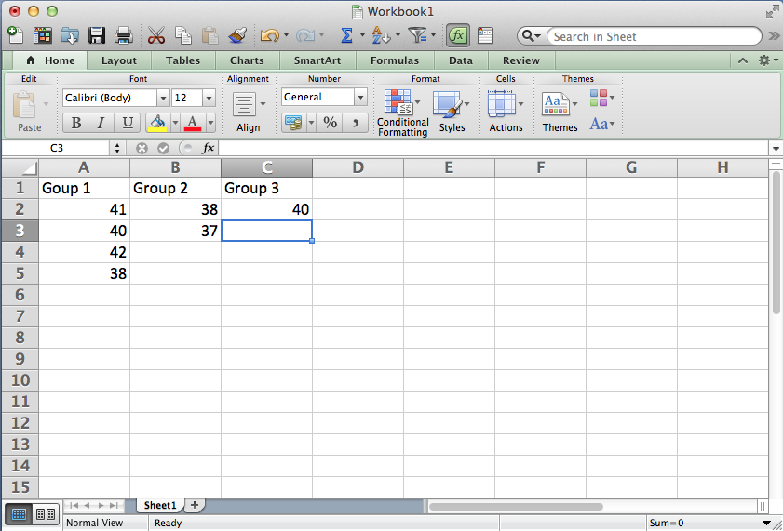
The data on this worksheet still reflect independent data with 3 groups.
However, the format shown here is referred to as an unstacked format. This format
often facilitates data analysis in Excel. To use this format the user converts
the stacked format into this format by creating separate variables for each group
and copying and pasting data from the original format after sorting data on the
grouping variable (i.e., the categorical variable).
Warning: rows no longer represent separate cases when data are arranged
in an unstacked format.

Slide 9
The unstacked format is a graphical representation of a frequency table. The frequency of a category (or class interval when the values are spread out) is the number of data values that fall in that category or range specified by that class interval.
Frequency Table
Category | Frequency
Group 1 | 4
Group 2 | 2
Group 3 | 1

Slide 10
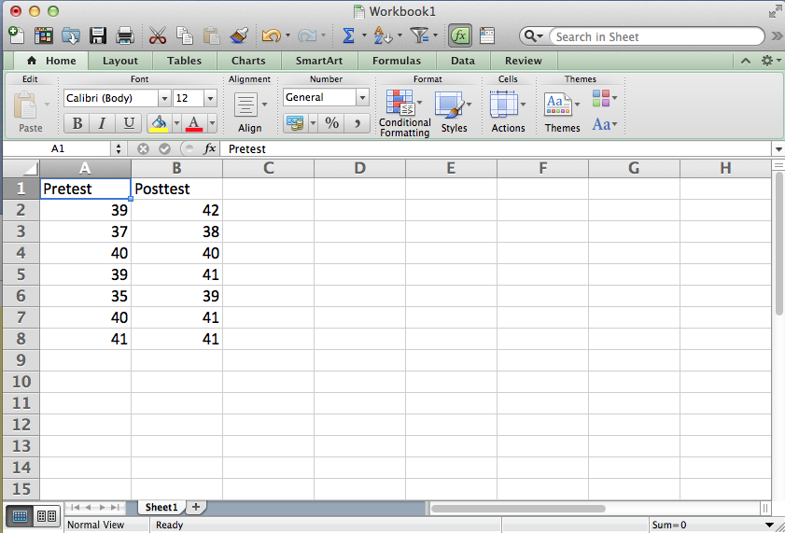
The data on this worksheet reflect dependent data.
Data are dependent when they consist of multiple measurements for the same subject (case). For example, case 1 receives a score of 39 on a pretest measurement and a score of 42 on a posttest measurement.
Warning: don’t confuse dependent data with unstacked independent data. Using dependent data, each row represents a different case whereas rows do not represent individual cases in an unstacked Independent data format.

Slide 11
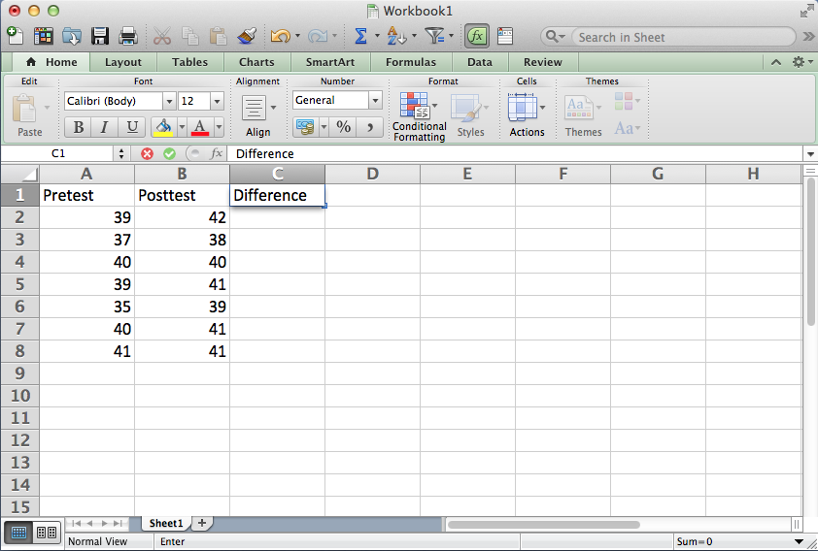
Select cell C1 and enter the text Difference.
Notice the text is displayed in both cell C1 and the formula bar
when cell C1 is active.

Slide 12
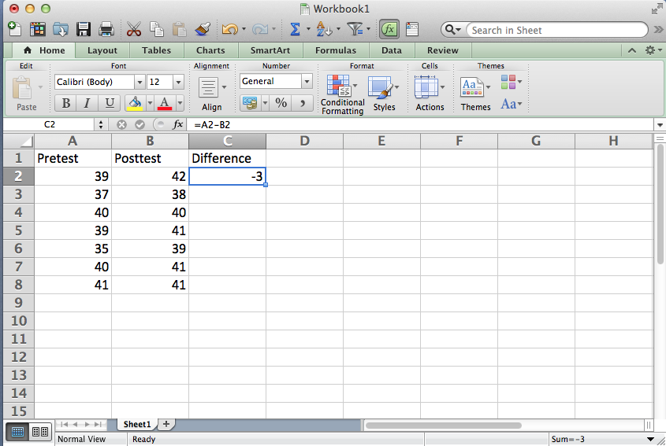
Select cell C2 and enter the formula =A2-B2.
Notice the following:
Formulas start with an equal sign
Formulas don’t contain spaces
The formula =A2-B2 subtracts the value
contained in cell B2 from the value
contained in cell A2
When cell C2 is active, the formula is
displayed in the formula bar
The result of the operation is displayed in cell C2

Slide 13
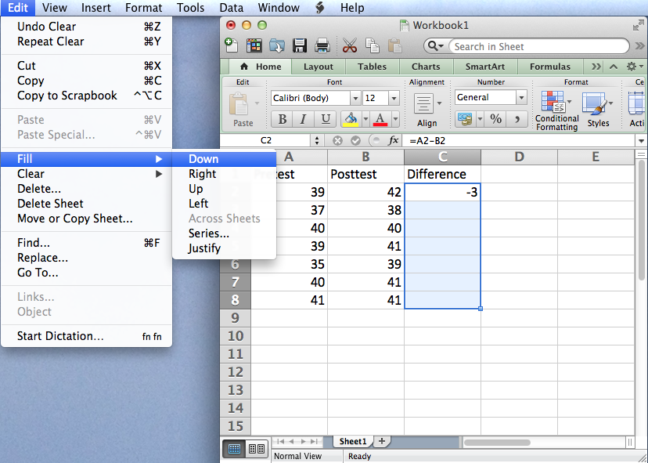
Select cell C2 and while holding the
Shift key down select cell
C8 in order to highlight cells C2:C8.
From the Edit menu select Fill Down.

Slide 14
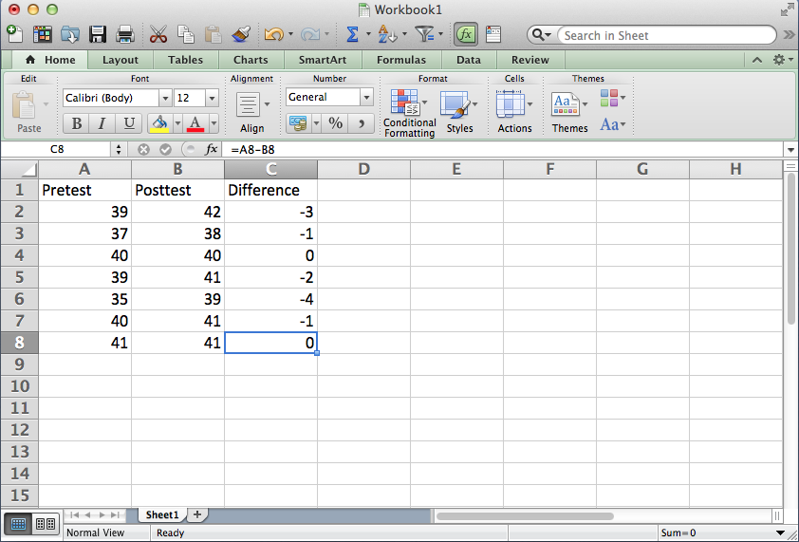
Excel replicates the formula from C2 down
to cell C8 using relative addressing.
The original formula =A2-B2 in cell C2 is
changed to =A3-B3 in cell C3, and so on
until cell C8 where the formula is
=A8-B8.
If absolute addressing were used (i.e.,
=$A$8-$B$8), all the formulas in cells
C2:C8 would be the same: =$A$8-$B$8
after the Fill Down operation.

Slide 15
Excel Syntax
The following are the most common arithmetic operators used in Excel formulas
+
for addition, e.g., =A1+A2
–
for subtraction, e.g., =A1-A2
*
for multi-plication, e.g., =A1*A2
/
for division, e.g., =A1/A2
Parentheses can be included to specify order of operations.
For example, =(A1+A2)/A3 will add the values of cells A1 and A2 and divide the sum by the value of cell A3.

Slide 16
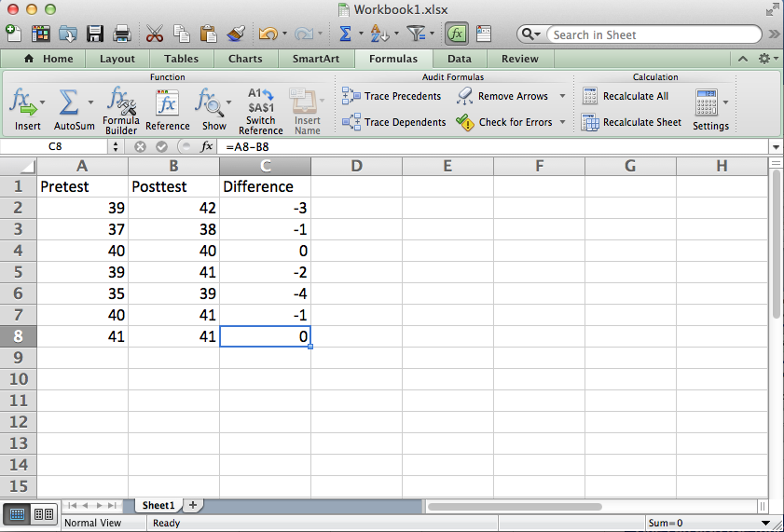
One can also use functions in Excel formulas.
View a list and description of all Excel functions by selecting the Excel Formulas tab and clicking the Reference icon.

Slide 17
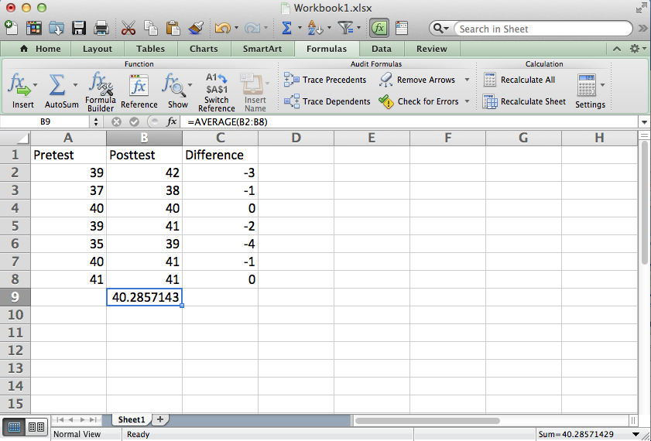
A useful function is the AVERAGE function defined as follows:
AVERAGE(number1,number2,...). Returns the arithmetic mean, where numbers represent the range of numbers.
For example, the formula =AVERAGE(B2:B41) in the displayed worksheet returns the arithmetic average or mean for the posttest variable.

Slide 18
Getting Started
End of Presentation

